Slide 1
Course
AWS Cloud Practitioner
MaxCloud

Slide 2
12
Class
AWS Well Architect Framework
AWS CAF
AWS SNOW FAMILY

Slide 3
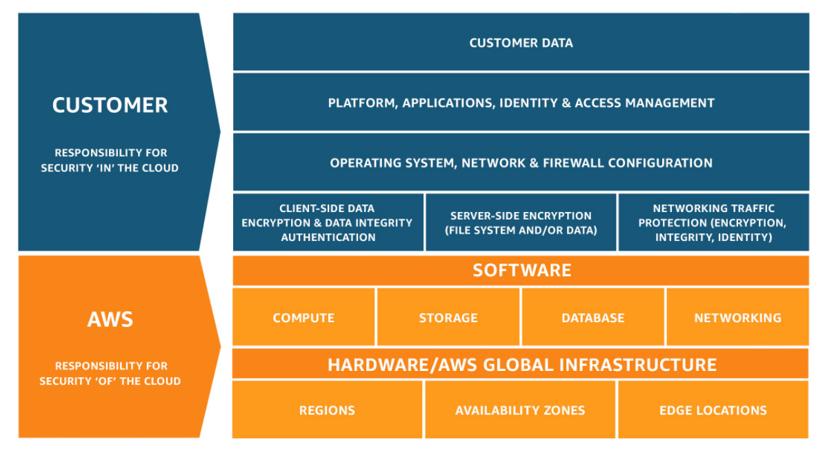
Shared Responsability Model

Slide 4
AWS Artifact
AWS Artifact provides on-demand downloads of AWS security and compliance documents, such as AWS ISO certifications, Payment Card Industry (PCI) reports, and Service Organization Control (SOC) reports.

Slide 5
monitoring and audit
Amazon CloudWatch
AWS CloudTrail
AWS Config

Slide 6
Security Services
Amazon Inspector
Amazon GuardDutty (AWS CloudTrail management events, AWS CloudTrail event logs, VPC flow logs, and DNS logs)
AWS Security Hub
AWS Shield
AWS WAF

Slide 7
Automation
AWS Secret Manager
AWS System Manager

Slide 8
Resources
AWS Knowledge Center
AWS Security Center
AWS Blog

Slide 9
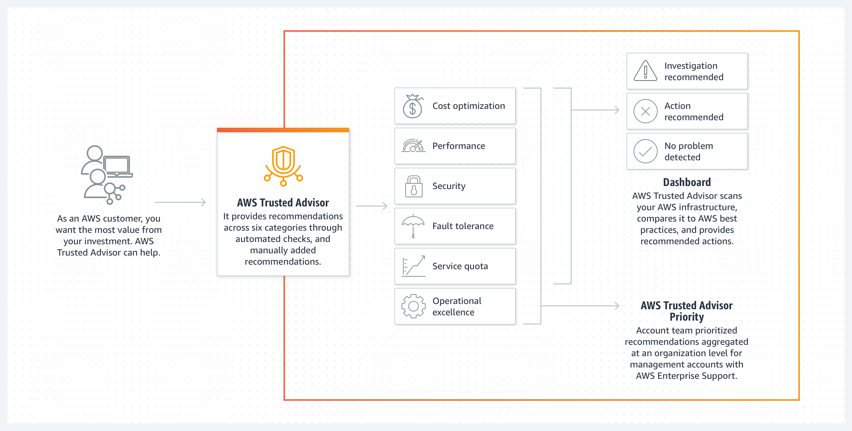
Trusted advisor

Slide 10
Muchas Gracias

